Slide 1
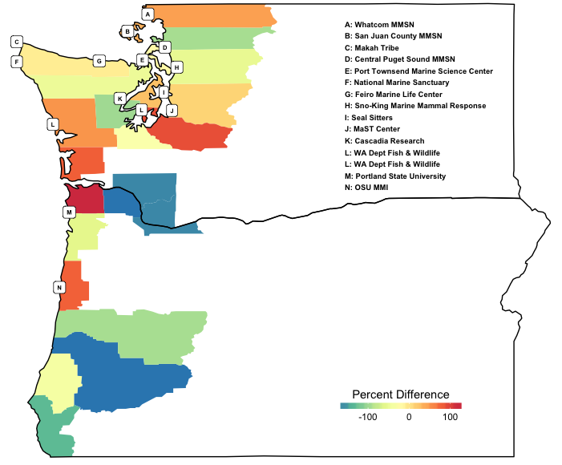
A: Whatcom MMSN
B: San Jan County MMSN
C: Makah Tribe
D: Central Puget Sound MMSN
E: Port Townsend Marine Science Center
F: National Marine Sanctuary
G: Feiro Marine Life Center
H: Sno-King Marine Mammal Response
I : Seal Sitters
J: MaST Center
K: Cascadia Research
L: WA Dept Fish & Wildlife
M: Portland State University
N: Oregon St. University MMI

Slide 3
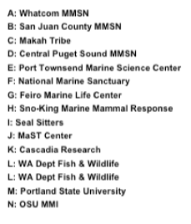
A: Whatcom MMSN
B: San Jan County MMSN
C: Makah Tribe
D: Central Puget Sound MMSN
E: Port Townsend Marine Science Center
F: National Marine Sanctuary
G: Feiro Marine Life Center
H: Sno-King Marine Mammal Repsonse
I : Seal Sitters
J: MaST Center
K: Cascadia Research
L: WA Dept Fish & Wildlife
M: Portland State University
N: Oregon St. Univ MMI

